Slide 1
Causal Inference on Treatment Data
Spring 2021
Group 3: Catherine Gao, Eve Washington, Siyuan Sang, Zi Fang

Slide 2
Project Overview
We will evaluate the performance and computational efficiency of three causal inference algorithms on computing the average treatment effect (ATE) on two distinct datasets.
Algorithm | Propensity Score Estimation
Propensity Matching + Propensity Score | L1 penalized logistic regression
Doubly Robust Estimation | L1 penalized logistic regression
Stratification | L1 penalized logistic regression

Slide 3
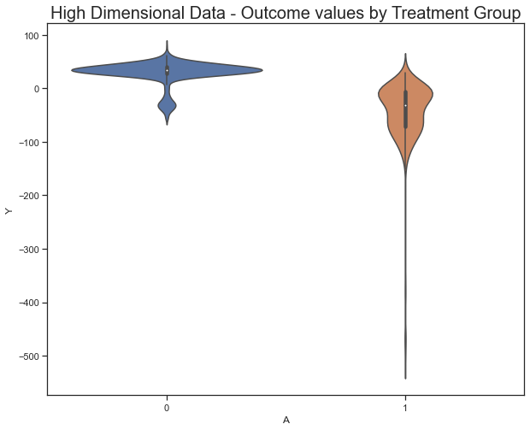
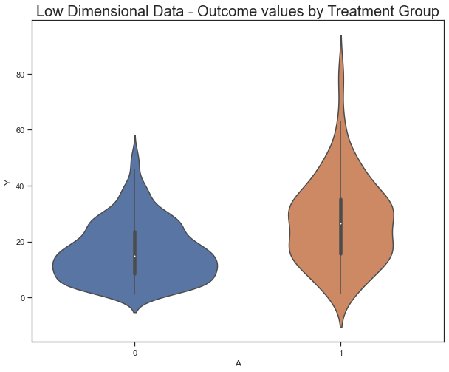
Data Preparation
Two datasets: high dimensional vs low dimensional
Notes:
The high dimensional data has 2000 observations and 187 variables.
The low dimensional data has 500 observations and 24 variables.
We use violin plots to visualize outcome values by treatment groups in both dataset to better understand the data. For the high dimensional data, we see that the outcome values of non-treated group mainly cluster between 0 to 50, but those of treated group below 0 and even have extreme values. For the low dimensional data, the outcome values are more evenly distributed between the treatment groups.

Slide 4
Propensity Score Estimation
Method: L1 penalized logistic regression
Two steps to improve accuracy of propensity scores:
Scale the features
Optimize hyperparameters for regression model
Notes:
We scale the features in the original dataset for regression models. Feature scaling is crucial because it helps to normalize the range of all features for distance calculation.
Tune for coefficient of regularization strength to control the flexibility of the model.

Slide 5
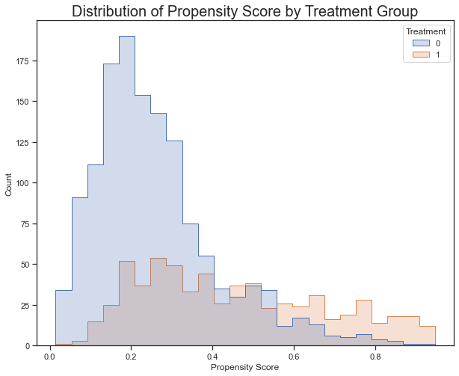
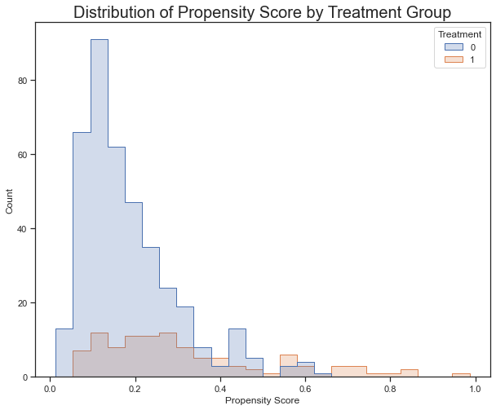
Propensity Score Estimation cont.
High Dimensional Data
Low Dimensional Data
Notes:
The estimated propensity scores for both the high and low dimensional datasets are skewed to the right for the non-treatment group and spread out for the treatment group. This will create some challenges for propensity score matching.

Slide 6
Algorithms
Algorithm | Overview
Propensity Matching + Propensity Score | Creates a series of matched sets in an optimal way so that each matched set contains at least one treated individual and at least one control individual.
Doubly Robust Estimation | Combines outcome regression model with weighting by propensity score model.
Stratification | Rank and stratify mutually exclusive subsets based on the propensity scores. Within each stratum, subjects have roughly similar values of the propensity scores.
Notes:
Doubly robust estimation remains consistent even if either the outcome model or the propensity model is incorrect.
For our stratification model – we stratified the propensity scores into 5 groups.

Slide 7

Evaluation and Comparison
Low Dim Data
Algorithm | Run Time | ATE | Accuracy
Propensity Scores Matching (full) | 1.7 | 0.36 | 17%
Doubly Robust Estimation | 0.11 | 2.09 | 100%
Stratification | 0.03 | 2.38 | 86%
High Dim Data
Algorithm | Run Time | ATE | Accuracy
Propensity Scores Matching (full) | 11.81 | -11.71 | 21%
Doubly Robust Estimation | 0.23 | -57.04 | 96%
Stratification | 0.03 | -59.83 | 91%

Slide 8
Conclusion
Propensity Score Matching has the longest run time and lowest accuracy of all three methods.
Stratification provides the least run time on all three models with a relatively high accuracy
Doubly Robust Estimation returns an ~ 100% accuracy on the low dimensional dataset and 96% accuracy on the high dimensional dataset
BEST MODEL!!!
Notes:
In summary, Propensity Score Matching has the longest run time and lowest accuracy of all three methods. This is due to the fact that the method goes through each sample and match the treated and non-treated unit based on propensity score, and yet the distributions of propensity scores for the non-treated group are skewed, resulting in some unmatched samples from the treated group.
On the other hand, stratification provides the least run time on all three models with a relatively high accuracy. The stratification method groups subjects with similar propensity scores into mutually exclusive stratum. This method is powerful in our scenario because it reduces the impact of the extremely unbalanced distribution of propensity scores between the treated and non-treated group by creating relatively more balanced subgroups.
Our best model is Doubly Robust Estimation, which returns an almost 100% accuracy on the low dimensional dataset and 96% accuracy on the high dimensional dataset. Doubly Robust estimation provides a simple way of combining linear regression with the propensity score to produce a doubly robust estimator, requiring only one of the models to be correct to identify the causal effect. Proven by our results, this algorithm outperforms the other models with its strong consistency and accuracy in prediction.

Slide 9
Thank You!

